Slide 1
Internet of Everything
Smart Office
Ritesh Mayya (A-26)
Mirza Nauman (A-28)
Pratiksha Naik (A-29)

Slide 2
Smart Office
What Is a Smart Office?
A smart office is a workplace where technology enables people to work better, faster and, of course, smarter. Beacons, sensors and mobile apps help employees perform menial tasks better and faster, so they have enough time to focus on growing businesses and innovating.

Slide 3
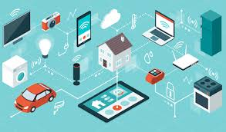
IoT Devices in Used in Smart office
Fire Detection System
RFID Authenticated doors
Web Camera Surveillance
Motion activated fans
Device Monitoring over cloud

Slide 4
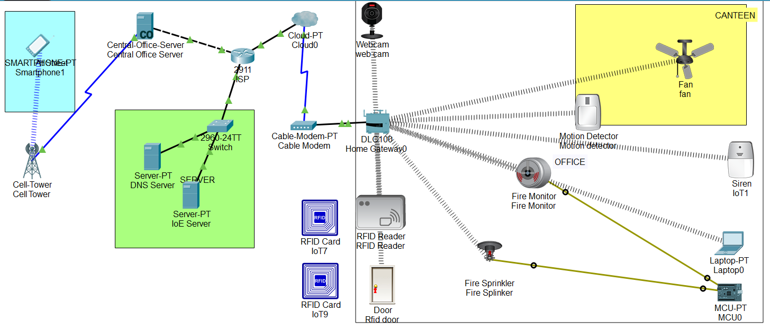
Smart Office System

Slide 5
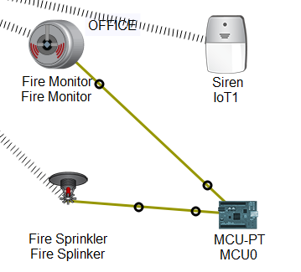
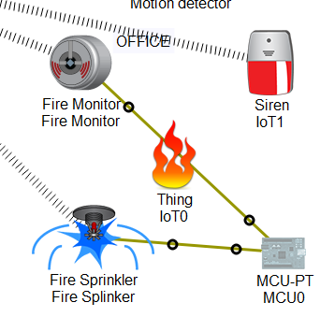
Fire Detection System

Slide 6
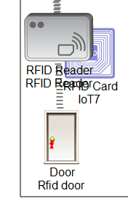
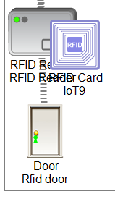
RFID Authenticated Doors

Slide 7
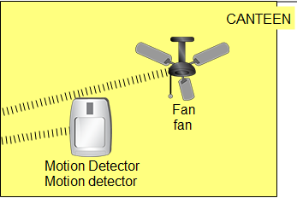
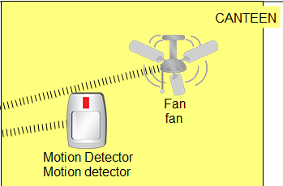
Motion Activated Fans

Slide 8

Webcam Surveillance

Slide 9
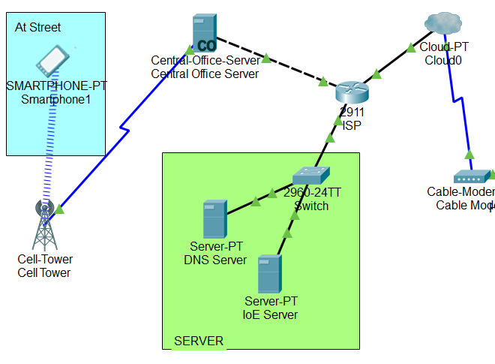
Networking

Slide 10
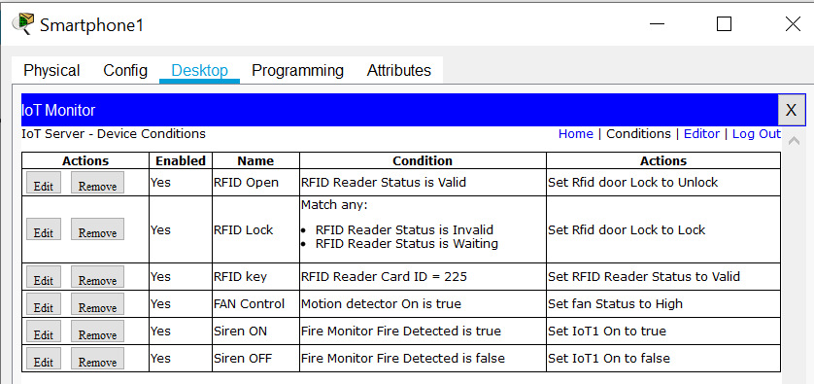
Conditions for IoT Systems

Slide 11
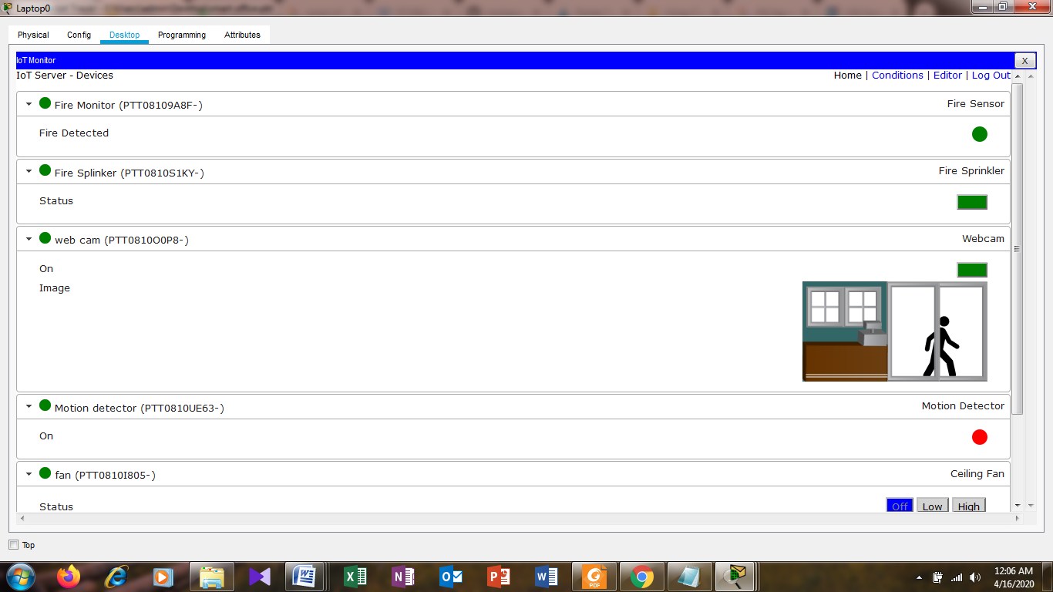
Result

Slide 12
Thank You

